Slide 1

Customer Shopping Behavior Analysis
This project analyzes customer shopping behavior using transactional data to uncover insights into spending patterns, customer segments, product preferences, and subscription behavior. Our goal is to guide strategic business decisions for enhanced business growth.
Notes:
1

Slide 2

Project Overview & Dataset Summary
Project Goal
Uncover insights into spending patterns, customer segments, product preferences, and subscription behavior.
Dataset Size
3,900 purchases across various product categories, with 18 columns of data.
Key Features
Customer demographics, purchase details, and shopping behavior metrics.
Missing Data
37 values in the 'Review Rating' column were identified and addressed.
Notes:
2

Slide 3
Exploratory Data Analysis with Python
01
02
Data Loading & Exploration
Missing Data Handling
Imported dataset using pandas; checked structure and summary statistics with df.info() and .describe().
Imputed 37 missing 'Review Rating' values using the median rating per product category.
03
04
Column Standardization
Feature Engineering
Renamed columns to snake_case for improved readability and consistency.
Created 'age_group' by binning ages and 'purchase_frequency_days' from purchase data.
05
06
Data Consistency Check
Database Integration
Verified and dropped redundant 'promo_code_used' column.
Loaded cleaned DataFrame into PostgreSQL for SQL analysis.
Notes:
3

Slide 4
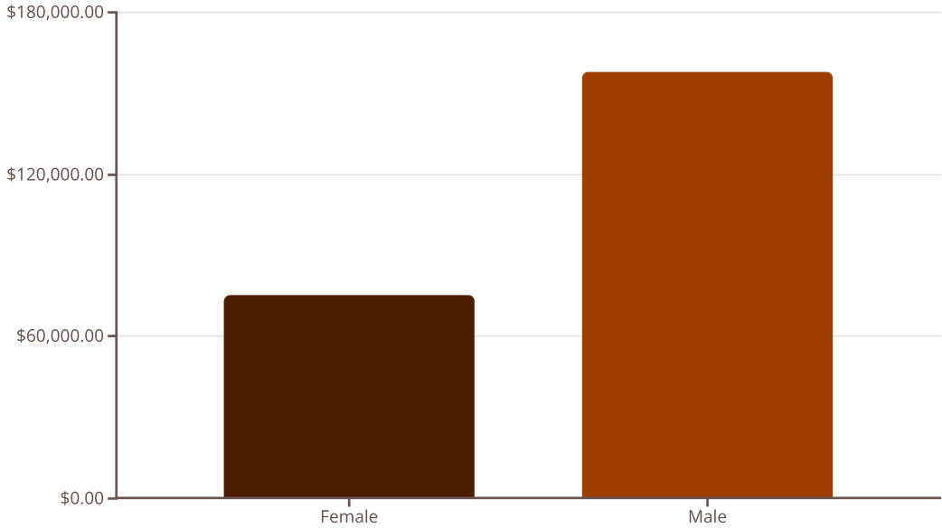

Revenue by Gender & High-Spending Discount Users
Revenue by Gender
High-Spending Discount Users
Identified 839 customers who used discounts but still spent above the average purchase amount, indicating effective discount targeting.
Male customers generated significantly higher revenue than female customers.
Notes:
4

Slide 5

Top Products & Shipping Insights
1
Top 5 Products by Rating
Gloves (3.86), Sandals (3.84), Boots (3.82), Hat (3.80), and Skirt (3.78) received the highest average review ratings.
2
Shipping Type Comparison
Express shipping had a slightly higher average purchase amount ($60.48) compared to Standard shipping ($58.46).
Notes:
5

Slide 6

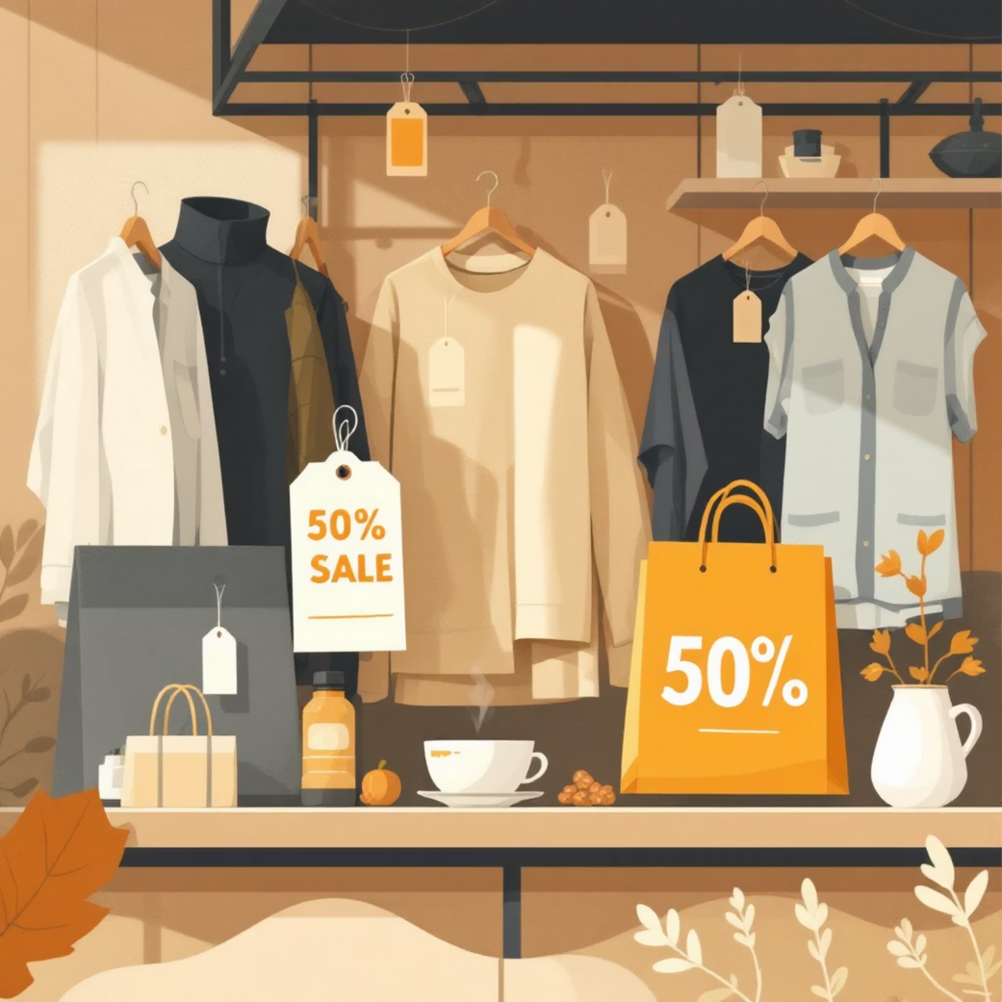
Subscription & Discount Analysis
Subscribers vs. Non-Subscribers
Discount-Dependent Products
Subscribers (1053 customers) had an average spend of $59.49, contributing $62,645. Non-subscribers (2847 customers) averaged $59.87, contributing $170,436.
Products with the highest percentage of discounted purchases include Hat (50%), Sneakers (49.66%), Coat (49.07%), Sweater (48.17%), and Pants (47.37%).
Notes:
6

Slide 7
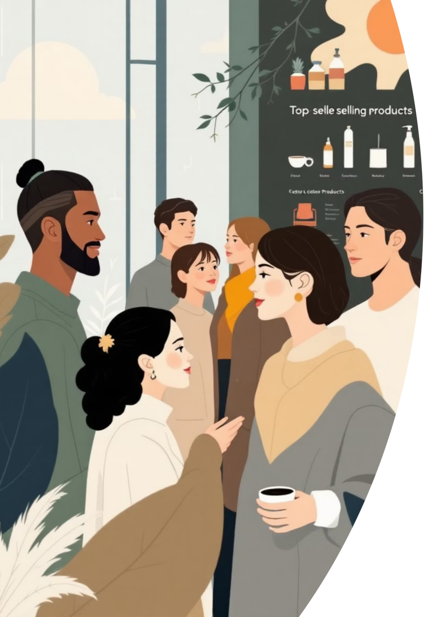
Customer Segmentation & Top Products by Category
Customer Segmentation
Customers classified into Loyal (3116), Returning (701), and New (83) segments based on purchase history.
Top Products per Category
Jewelry, Blouse, Sandals, and Jacket were the most purchased items in Accessories, Clothing, Footwear, and Outerwear, respectively.
Notes:
7

Slide 8
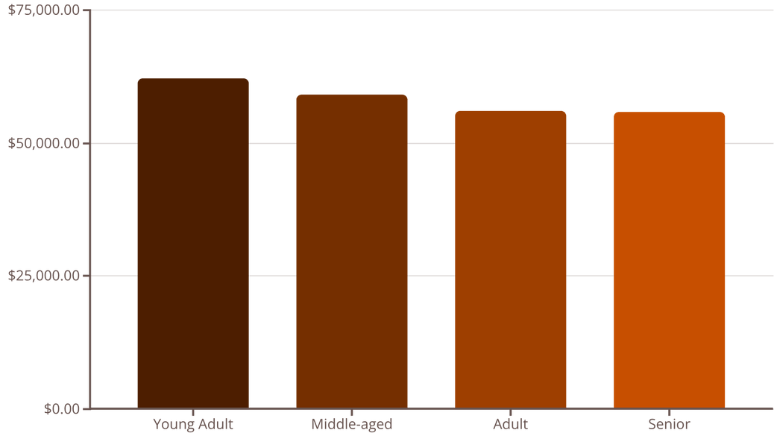

Repeat Buyers & Revenue by Age Group
Repeat Buyers & Subscriptions
Revenue by Age Group
Out of 3476 repeat buyers, 958 (27.5%) are subscribers, indicating a correlation between repeat purchases and subscription status.
Young Adults generated the highest revenue, followed closely by Middle-aged customers.
Notes:
8

Slide 9
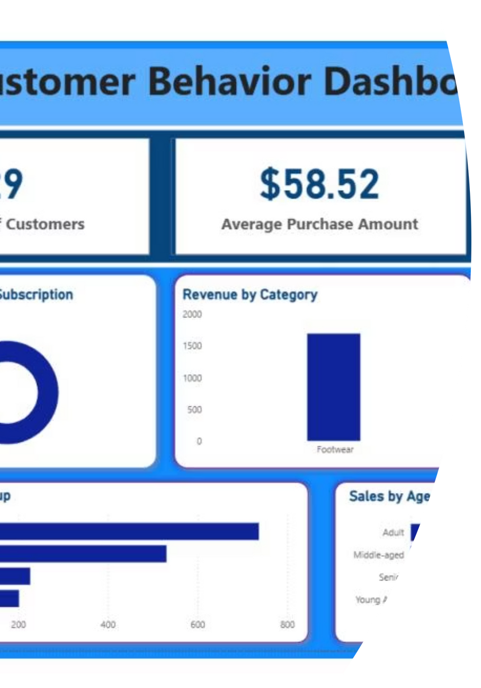
Interactive Dashboard in Power BI
An interactive dashboard was developed in Power BI to visually present all key insights, allowing for dynamic exploration of customer shopping behavior data.
Notes:
9

Slide 10





Business Recommendations
Boost Subscriptions
Promote exclusive benefits to increase subscriber base.
Customer Loyalty Programs
Reward repeat buyers to foster loyalty and move them into the "Loyal" segment.
Review Discount Policy
Strategically balance sales boosts with margin control to optimize profitability.
Product Positioning
Highlight top-rated and best-selling products in marketing campaigns.
Targeted Marketing
Focus efforts on high-revenue age groups and express-shipping users for maximum impact.
Notes:
10

